Slide 1
Leading Innovative Teaching & Learning in the 21st Century
Fostering innovation and excellence in teaching within an accountability environment
Hug High School
2013-2014

Slide 2
“In the future they will divide human history into Before the Internet and After the Internet.” (BI/AI) Veronica “Nicky” Silber (2013)

Slide 3
The Problem: Critical need to assess Innovative Teaching & Learning
Classroom measures of teaching practice and student learning
????
????
Narrow Performance Accountability Targets
Risk Indicators
Grad Rate & HSPE Status
Achievement Gap Indicators
Credit Deficient

Slide 4
Missing or underdeveloped in accountability systems
Standards (CCSS)
Core Curriculum/ Instruction
Assessment (SBAC)

Slide 5
Instructional Core
Student
Teacher
CCSS

Slide 6
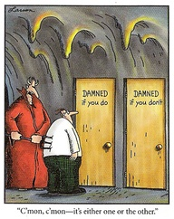
Paradox: Accountability vs. Sustainable Improvement

Slide 7
To what extent do the following measures inform and support teachers in improving:
Teaching Practice?
Learning Activities?
Student Outcomes?

Slide 8
Current data indicators
Graduation Rate
Achievement Gap indicators
Diploma types (Standard/Advanced/Honors)
Climate Student & Family Engagement surveys
Credits earned/attempted/deficiency
HSPE Status
GPA
AP access/completion/performance
Sped/LEP/FRL/Gifted status
Risk Index: Attendance/tardies/behavior/transient
Maps (math & reading)
CRTs (math & reading)
Course Failures & INC
District Math Final scores
Grades (percentages & scores)
Credits Recovered
?

Slide 9
Instructional Core
Grad Rate
AP Part & Perf
Credit Deficient
HSPE Status
MAPs
GPA
CRTs
Risk Indicators
Grades
Achieve Gap Indicators
IEP, ELL, FRL Status
???
???

Slide 10
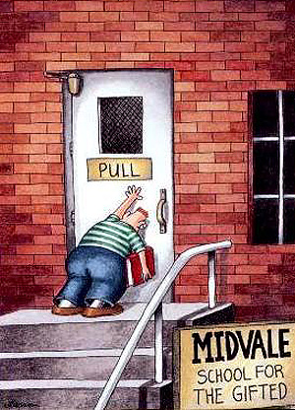

Slide 11
To what extent do the following measures inform and support teachers in improving:
Teaching Practice?
Learning Activities?
Student Outcomes?

Slide 15
Designing and fostering a culture of ‘Innovative Teaching & Learning’ (ITL)
What does ‘innovation in instruction’ mean?
What are some important 21st Century skills?
Why is ‘innovation in instruction’ important?
What are the conditions for supporting innovative teaching practices?
How do you lead innovative processes?

Slide 16
What does ‘innovation in instruction’ mean?
Innovative teaching practices
… are student-centered
Collaboration, knowledge building, self-regulation/assessment, skilled communication, personal relevance
… extend learning beyond the classroom
Critical thinking & problem solving, real-world innovation, cross-disciplinary that fosters global awareness, 24/7 learning
… integrate Information & Communication Technology (ICT) into teaching and learning
To meet specific concrete learning goals

Slide 17
What are some important 21st Century skills?
Collaboration
Knowledge building
Use of Information and Communication Technology (ICT) in learning
Real-world problem solving
Self-regulation
Professionalism

Slide 18
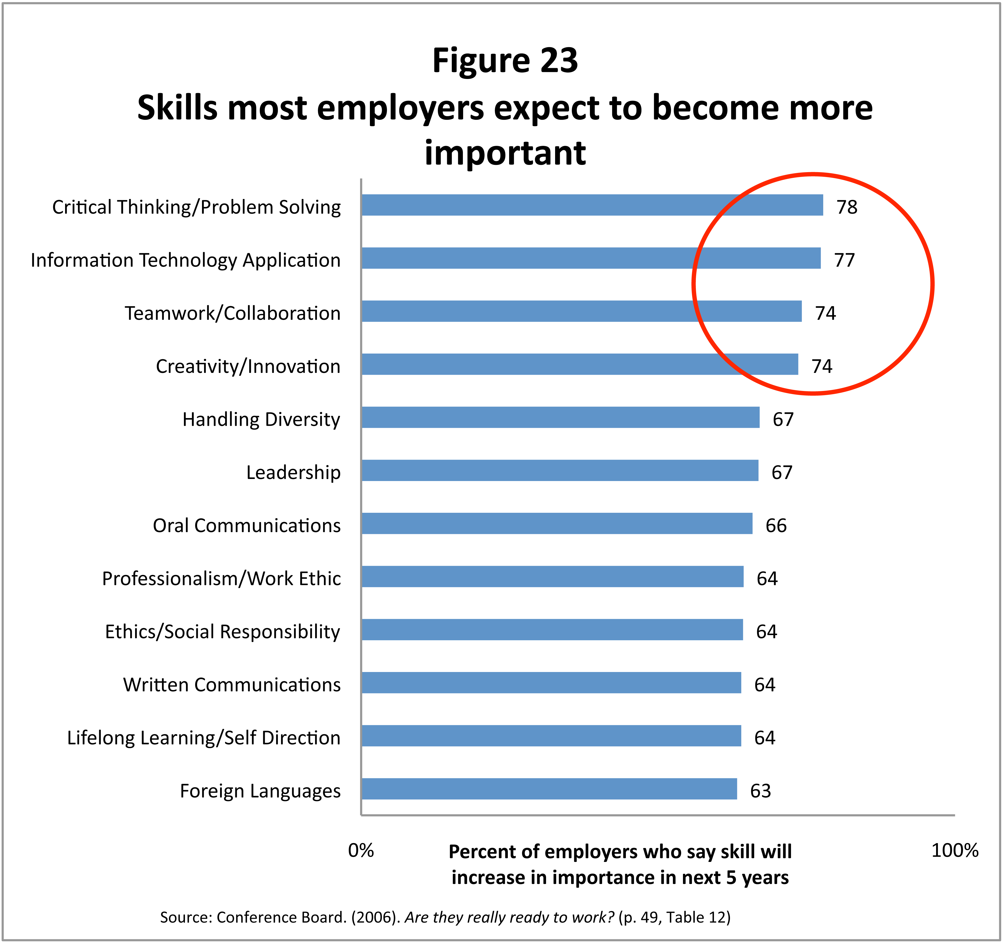
Why is ‘innovation in instruction’ important?

Slide 19
To what extent do the following measures inform and support teachers in improving:
Teaching Practice?
Learning Activities?
Student Outcomes?

Slide 20
Frequency of Innovative Teaching and Learning Practices
Innovative Teaching & Learning Practices No. of Lessons |  | %
Students have opportunities to connect learning to their own lives or to the real world | 48 | 69.6
Students give feedback to other students or receive feedback from other students or the teacher | 45 | 65.2
Students work in small groups or pairs | 42 | 60.9
Students actively generate new knowledge | 34 | 49.3
Students work on an in-depth project | 34 | 49.3
Students get prompted to assess the state of their own learning | 27 | 39.1
Students revise their work based on feedback or self-assessment | 27 | 39.1
Students have choices about the tools/resources used to learn | 23 | 33.3
Students engage in performance assessments or presentations of learning portfolios | 16 | 23.2
Students have choices about what they learn | 16 | 23.2
Students have opportunities to develop cross-cultural understanding | 14 | 20.3

Slide 21
Students use of ICT

Slide 23
What are the conditions for supporting innovative teaching practices?
21st Century Professional Learning Vision
Professional Learning Goals
Teacher Leaders & Innovators
Data-informed Openness (scale-up)
Innovative Teaching & Learning (ITL) Teams
Mobilize Resources & Incentives
Collaboration & Empowerment

Slide 24
An innovative culture
21st Century Professional Learning Vision
Data-informed Openness (scale-up)
Mobilize Resources & Incentives
Collaboration & Empowerment
21st Century Professional Learning Vision
21st Century academic and workforce readiness.
Mobilize and Prioritize Resources & Incentives
Dedicate funding; Use of time; Access to PD;
Instructional materials; Leadership recognition.
Collaboration & Empowerment
Ownership and autonomy to make important decisions; Trust and communication centered around improving teaching practice.
Data-informed Openness (scale-up)
Share data and results openly, spread ideas, create opportunities for influence, and communicate signs of success with all teachers.

Slide 25
21st Century Professional Learning Goals
Professional Learning Goals
Increase innovation in instruction
Increase the use of important school, teacher, & classroom measures
Increase collaboration & teacher leadership
Establish Professional Learning Networks
Increase the level of autonomy and ownership of learning
Increase quality teaching and learning using ICT

Slide 26
How do you lead innovative processes?
Teacher Leaders & Innovators
Teacher Leaders & Innovators
Learning requires receptiveness to new ideas and information, and Rogers' (1995) influential work on the diffusion of innovation:
• innovators (2.5% of the population)
• early adopters (13.5%)
• early majority (34%)
• late majority (34%)
• laggards (16%)

Slide 27
School Leadership
Department Leaders
ITL
Department
MTSS Team
ITL Leadership
Dep't Specific Goals
Credit Attainment
HSPE Status
AP Completion & Performance
Leadership & Collaboration
Innovative Teaching & Learning
Improve Measures
Autonomy & Ownership
District Initiatives
Academic Interventions
Behavioral Interventions
Classroom Environment
MTSS Leadership
Parent & School Connections
Graduation Indicators
Admin Team

Slide 28
Innovative Teaching & Learning (ITL) Teams … Alignment
Innovative Teaching & Learning (ITL) Teams
ITL Teams
PGP Instructional Problem or Question(s)
21st Century Skills
TPGS
CCSS

Slide 29
Innovative Teaching & Learning (ITL) Planning Process
Innovative Teaching & Learning (ITL) Teams
Form ITL Teams (Common Focus)
Determine Team Leader
Establish Teacher & Student Outcomes
Design Action Plan (PGP)
Identify Resources Needed
Implement Measure Analyze Reflect Share

Slide 30
Ideas for 21st Century ITL teams
Innovative Teaching & Learning (ITL) Teams
Digital tools for teaching
Brain research and teaching kids in poverty
Collaborative problem-solving
ICT literacy- learning in digital networks
Pre-AP/AP vertical curriculum articulation
Problem-based learning (PBL)
Writing across the curriculum
Social Studies (Assessing DBQs)
Health Science Academy & Workforce Readiness Skills
Literacy strategies aligned to CCSS

Slide 31
Professionalism
Implementation
Active engagement & participation
Collaboration
Collective responsibility
Alignment
CCSS, TPGS, 21st Century Skills, and school goals &targets
Coherence (PGP)
Common focus: Long-term commitment over school year
Improve School & Classroom Measures
Innovative teaching practices, learning activities, and 21st Century learning outcomes

Slide 32
Timeline: Laying ITL foundation
May 2013
21st Century Innovative Teaching & Learning Vision Meetings
June 2013
Network for ITL Teams
Professional Learning: Wednesdays, Prep Periods, Staff Meetings & Extended Contract Time
- Dep’t
- ITL
July 2013
August 2013
Ongoing 2013-2014
Summer PD Team
ITL Leadership Vision & Direction
- MTSS
- District CCSS Initiative

Slide 33
Next Steps: To-Do
Network and think about ideas for ITL teams (Who? Focus?)
Technology Needs Assessment Survey
Submit 3 Typical Lesson plans
Professional Learning & Leadership Opportunity: (Summer)

Slide 34
“We’re still learning where we’re going as we go.” Howard Lo (2013) Questions/Discussion

